Slide 1

SNOW SUMMIT
2013-2014
MONTGOMERY COUNTY MARYLAND
DEPARTMENT OF TRANSPORTATION
DIVISION OF HIGHWAY SERVICES
Gaithersburg Depot
17000 Crabbs Branch Way, Gaithersburg, Maryland
November 1, 2013

Slide 2
Today’s Game Plan
Introductions and Welcoming Remarks
The Storm Challenge
Game Readiness
Team Readiness
Fan Base Statistics
MC Opponent Storm Analysis, Forecasting, Notifications, and Considerations
The Coaches Conference Room
Game-on! (Taking the Field on Game Day)
Post Game
Postseason

Slide 3
Introductions
County Executive - Isiah Leggett
Chief Admin. Officer - Timothy Firestine
Assist. Chief Admin. Officer - Tom Street
Director DOT - Arthur Holmes, Jr.
Deputy Director DOT - Al Roshdieh
Chief, Fire and Rescue - Steve Lohr
Chief MCPD - J. Thomas Manger
Director Homeland Security - Chris Voss
Public Information Officer - Patrick Lacefield
MC311 Call Center - Leslie Hamm
SHA Assistant Dist. Eng. (Maint.) - Tom Fountain
SHA Resident Maint. Eng's. - Greg Edwards (Gaithersburg) and John Ritter (Fairland)

Slide 4
Introductions
DHS Chief - Keith Compton
Field Operations Chief - Richard Dorsey
Storm Operations Center Director - Randy Paugh
Storm Operations Center Manager - Steve Suprata
Contract/Logistics Coordinator - Jeffery Knutsen
Environmental Services Chief - Brett Linkletter

Slide 5
Introductions
DHS District Supervisors:
  Louis Machetto (Bethesda Depot)
  Gregory Bryant (Colesville Depot)
  William “Billy” Mead (Gaithersburg East Depot)
  Chester “Chuck” Haynes (Gaithersburg West Depot)
  Larry Herron (Silver Spring Depot)
DHS Contractor Supervisors
  John Birton
  Donald Noble

Slide 6
Welcoming Remarks
DOT Director – Art Holmes

Slide 7
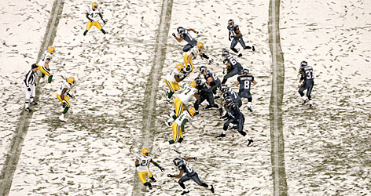
The Storm Challenge
Inform public and private sectors of DOT procedures for management of the 2013-2014 Snow Season
Public Outreach
  Inform the public
  Inform elected officials
  Transparency
    Manage public expectations
    Temper public expectations
  Provide reliable information
  Real-time information
  Storm Operations Map
  YouTube, Twitter,
  CATV Channel 6,

Slide 8
Game Readiness
When you consider the term "game readiness;" it's an ongoing activity which includes:
  planning
  coordinating
  training staff
  preparation of equipment
  contracts solicitation
  materials acquisition
Notes:
8

Slide 9
Team Readiness
What do we plan for? (Planning “Drivers”)
  Weather Forecasts (“Plan for the worst and hope for the best.”)
  Equipment Operators
  Supervisors and Managers
  Contract Support (regional competition)
  Materials

Slide 10
Team Readiness
MOC Storm Day (Scrimmage Game)
Snow Summit (Pep-rally)
Updated Snow Book (Play Book)
Enhanced communications (internally & externally)
Fleet (restore and maintain all equipment ready to go)
Contractors (manpower, equipment, materials and services)
Salt, sand and salt brine stockpiles are currently at capacity
Food for the Game

Slide 11
Team Readiness
Practice, Plan, and Prepare
DHS staff, Fleet Management staff, and contractors are experienced and professional seasoned veterans
Train new Depot employees (Snow Plow Best Practices)
Train SOC staff (Web EOC, NIMS 100 & 200)
Quick to obtain additional team players and snow removal equipment

Slide 12
Team Readiness
Contractor Reserve List
  Contractor equipment inspections and calibrations are conducted from November 3, 2013 to November 10, 2012
  Equipment pay rates are determined according to the equipment presented during inspection
  Provided with updated GIS plow maps and County Inspectors contact information
  Provided with updated TomTom navigation information

Slide 13
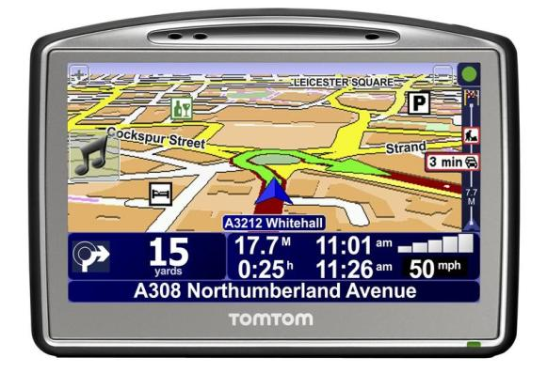
Team Readiness
13
TomTom® Plow Route Navigation
  Provides turn by turn navigation
  Increases efficiency
  Reduces missed streets
  Portable
  Used in contract vehicles and County trucks
  This Initiative received the County Engineers Association of Maryland (CEAM) Small Award of Merit for 2012
  DOT was named a winner of the 2012 National Association of Counties (NACo) Achievement Awards for this Initiative.

Slide 14
Montgomery County Fan Base Statistics
602 lane miles of Emergency Routes
364 lane miles of Salt Routes
4157 lane miles of
Neighborhood Plow Routes
Clears approximately
5123 lane miles

Slide 15
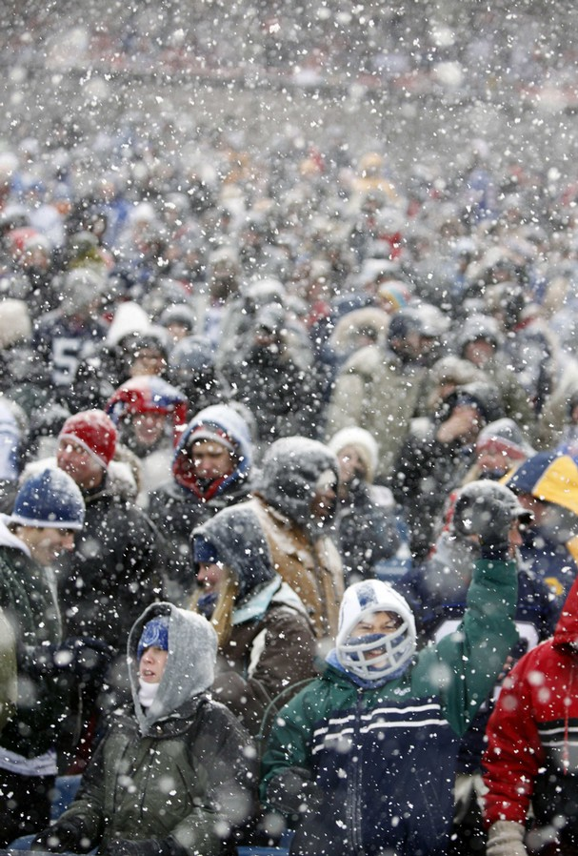
Montgomery County Fan Base Statistics
989,794 Residents (US Census 2011 estimate)
202 Schools
4 Urban Areas (Bethesda, Silver Spring, Wheaton, Clarksburg)
26,430 Private Business
Establishments
(US Census 2010 estimate)
Over 250 biotech companies
along the I-270 Technology
Corridor Park

Slide 16
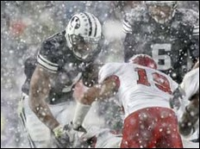
Storm Analysis, Forecasting, and Notification
Blends the art and science of snow and ice control
Leads to a cost-effective, higher level of service for our customers
Mitigates negative impact of winter operations on the
highway system
Mitigates economic impacts
across the county
Keeps ahead of advancing
adverse weather by
monitoring forecast
Notes:
16

Slide 17
Storm Analysis, Forecasting, and Notification
17
Highway Services is notified by
  Alert Montgomery
  AccuWeather®
  National Weather Service
  Earth Networks™
  Other sources such as
  national news
Notes:
17

Slide 18

Season Forecast
18
18

Slide 19
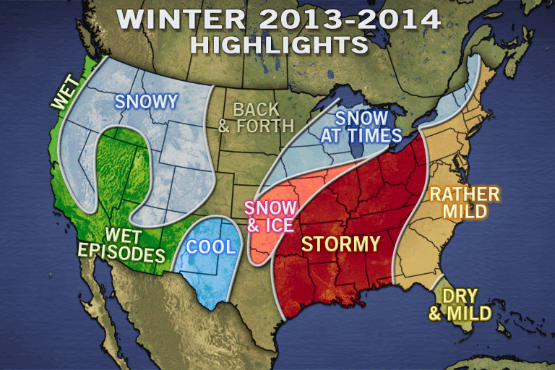
AccuWeather®
19

Slide 20
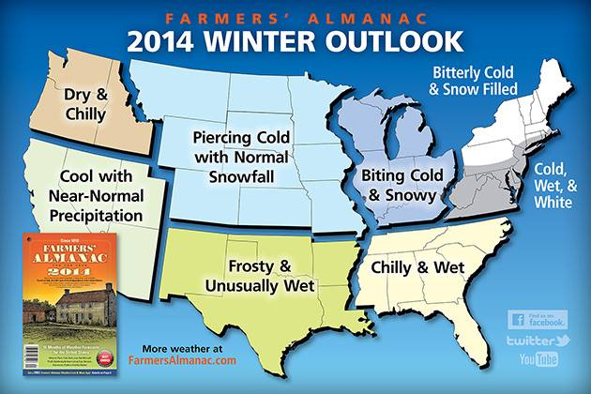

Slide 21
Storm Analysis, Forecasting, and Notification
Notifications vary from 5-days out to less than 48-hours
  Winter Weather Advisory
  Snow Advisory
  Winter Storm Watch
  Winter Storm Warning
  Blizzard Watch
  Blizzard Warning

Slide 22
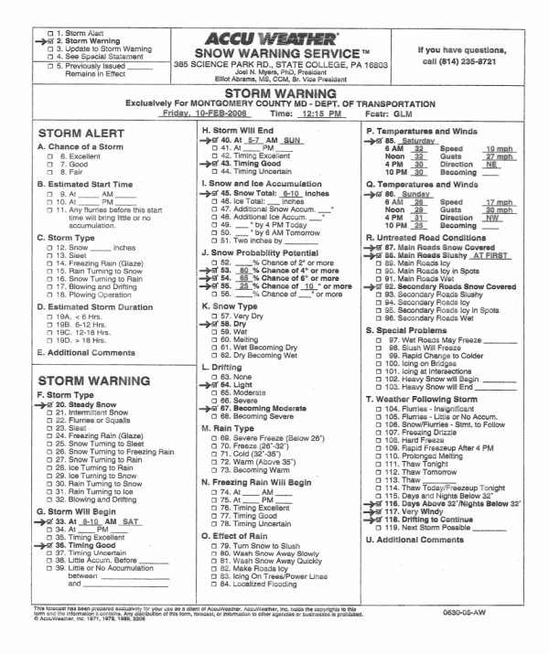
Storm Analysis, Forecasting, and Notification
National notification from AccuWeather® (2,000 mile view; 3-5-days out)
AccuWeather® Special Statement (1,000 mile view; 2-3-days out)
AccuWeather® Alert (500 mile view; 36-48 hours out)
AccuWeather® Warning (100 mile view; < 36 hours out)
Earth Networks™ (local “real- time” weather conditions)
22
Notes:
22

Slide 23
Storm Analysis, Forecasting, and Notification
  Increased real time “intelligence” using local forecasting capability (satellite and ground monitoring weather stations)
    Over 300 Earth Networks™ weather stations located in Metro Region
    Storm response strategy and mobilization decisions based on forecasts, predictions, and real time information
Conference calls are conducted with meteorologists
SOC issues daily internal weather forecast at 2:00pm

Slide 24

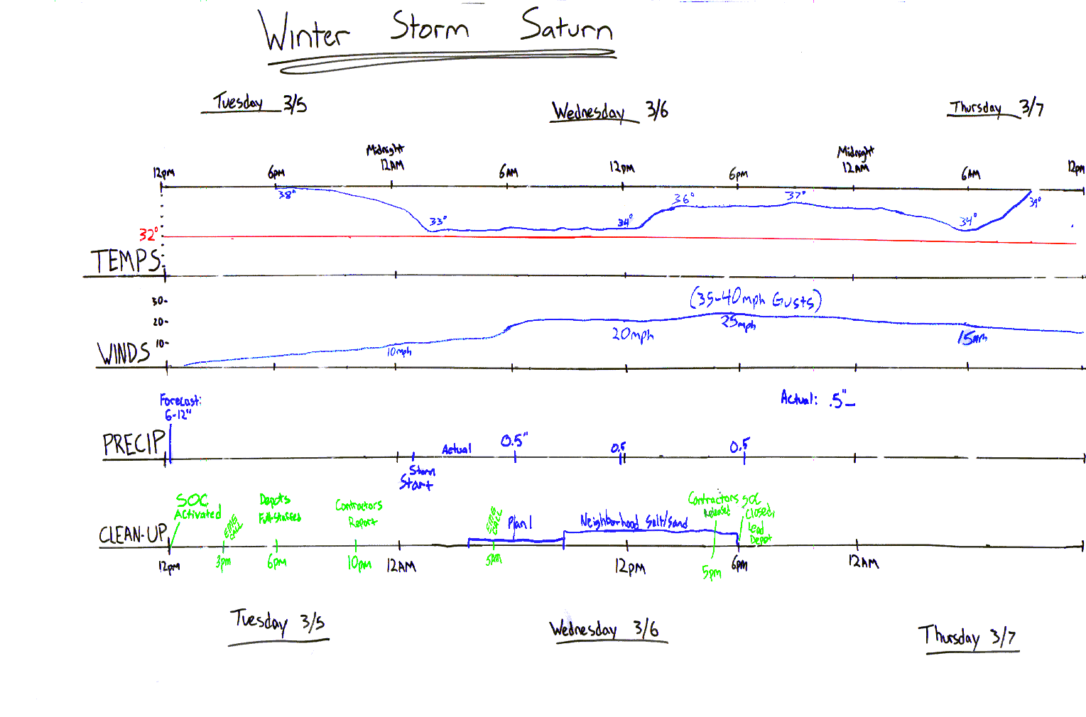
Storm Analysis, Forecasting, and Notification

Slide 25

Storm Analysis, Forecasting, and Notification
In addition to weather forecasting and notification, DHS is considering the benefits of pavement forecasting and notifications.
  Precise timing when pavement temperature will go above and below freezing
  Decision support such as chemical applications amount and timing
  Road temperatures
  Road weather event information
    Frost
    Black ice
    Freezing Rain (freezing where?)
  Real-time updates

Slide 26
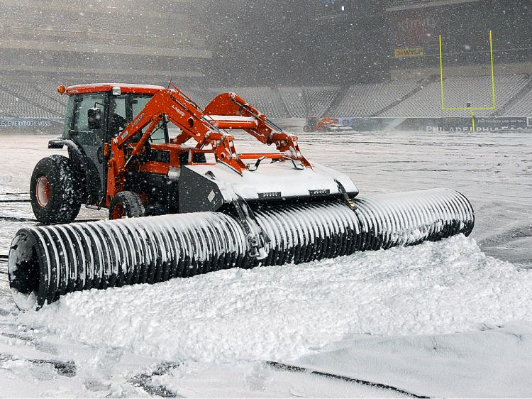
Game Day Forecast Considerations
Pavement forecast considerations
  Weather forecast (type of precipitation)
  Air temperature
  Dew point
  Pavement temperature
  Moisture
  Wind speed and direction
  Duration
  Timing of next storm event
  (back-to-back storms)

Slide 27

The Coaches Conference Room -
Storm Operations Center (SOC)

Slide 28
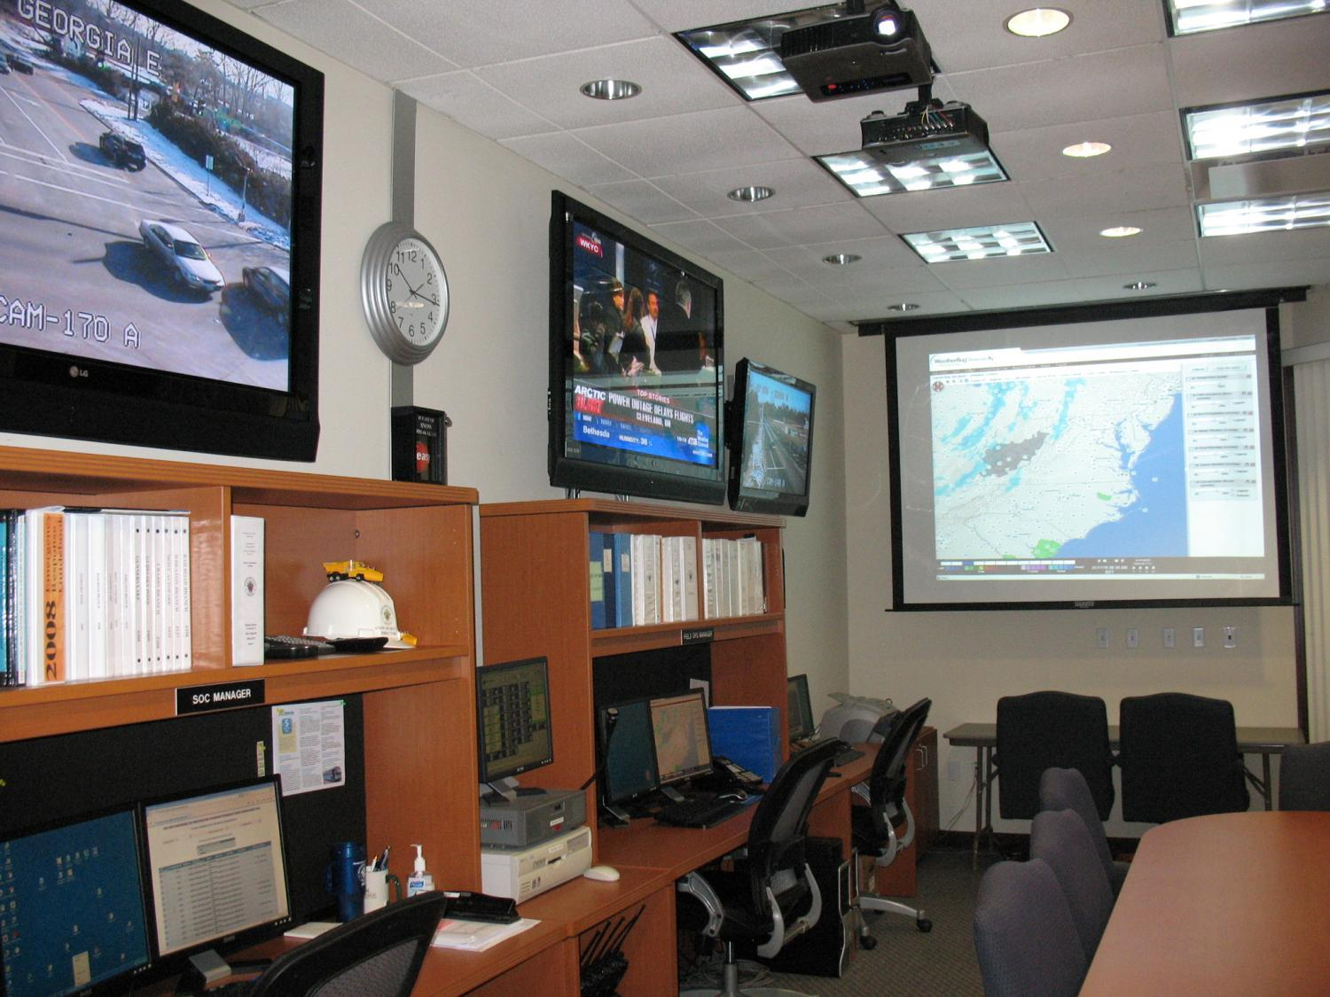

Slide 29
The Coaches Conference Room -
Storm Operations Center (SOC)
Glean intelligence about the scope and magnitude of the event
Develop a coordinated response to the event
Management of human, equipment and contractual resources
Interface with EOC
Manage Storm Operations Map
Manage road closure database
Verify and validate field information
Generate reports of current conditions

Slide 30
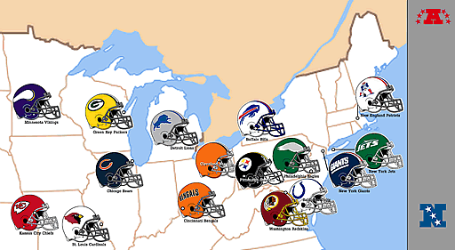
The Coaches Conference Room -
Storm Operations Center (SOC)
The Storm Operations Manager coordinates information with other leagues
  National level
    National Incident Management System (NIMS)
  State level
    Maryland Emergency Management Agency (MEMA)
    Maryland State Highway Administration (SHA)

Slide 31
The Coaches Conference Room -
Storm Operations Center (SOC)
The Storm Operations Manager coordinates information with special teams
  Local level
    Emergency Operations Center (EOC) - Interface with WebEOC
    Utilities (PEPCO, etc.)
    Emergency Management Group (EMG)
    Council of Governments (COG)
    Montgomery County Homeland Security
    Montgomery County 311
    Transit Services
    Montgomery County Police Department (MCPD)
    Montgomery County Fire & Rescue Service (MCFRS)

Slide 32
The Coaches Conference Room -
Storm Operations Center (SOC)
GIS locations of schools, hospitals, fire stations, metro stations, bus stops, etc.
Observing real-time weather and pavement conditions
  192 Cameras
Division Chief and Managers confer on operations
Directives issued to the field
Interface with public, website, multi-media, interviews, customer service center and snow applications map

Slide 34
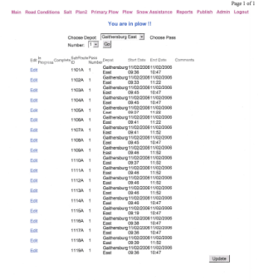
The Coaches Conference Room -
Storm Operations Center (SOC)
The SOC provides messages based on depot input.
Residents can enter addresses to get plowing information.
34
Evaluate field report using Snow Tracking Application (Score Book
  Communication between Depots and SOC
  Track Progress
  Resource Leveling

Slide 35
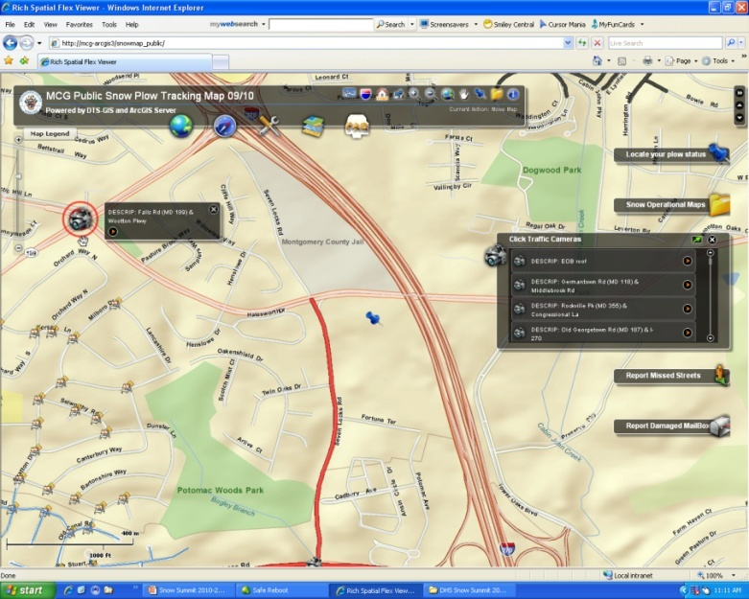
The Coaches Conference Room -
Game Day Stats
Storm Operations Map
  Leading-edge Technology
  Keep residents informed
    Storm operation progress
    When is it safe to leave my house?
    How do I plan a trip to a destination?
    What mode of transportation should
    I use?

Slide 36
The Coaches Conference Room -
Game Day Stats
Storm Operations Map
  Updated through Storm Apps
  Database
  Robust Functionality
    Flexible Address Search – “Google Like”
    Plowing Progress
    Emergency Roads
    Traffic Camera Layer
    Metro & Bus Stop Layer
    Hospital & School Locations
    Fire Hydrant Locations
    Link to Maryland State Highway Road Conditions

Slide 37
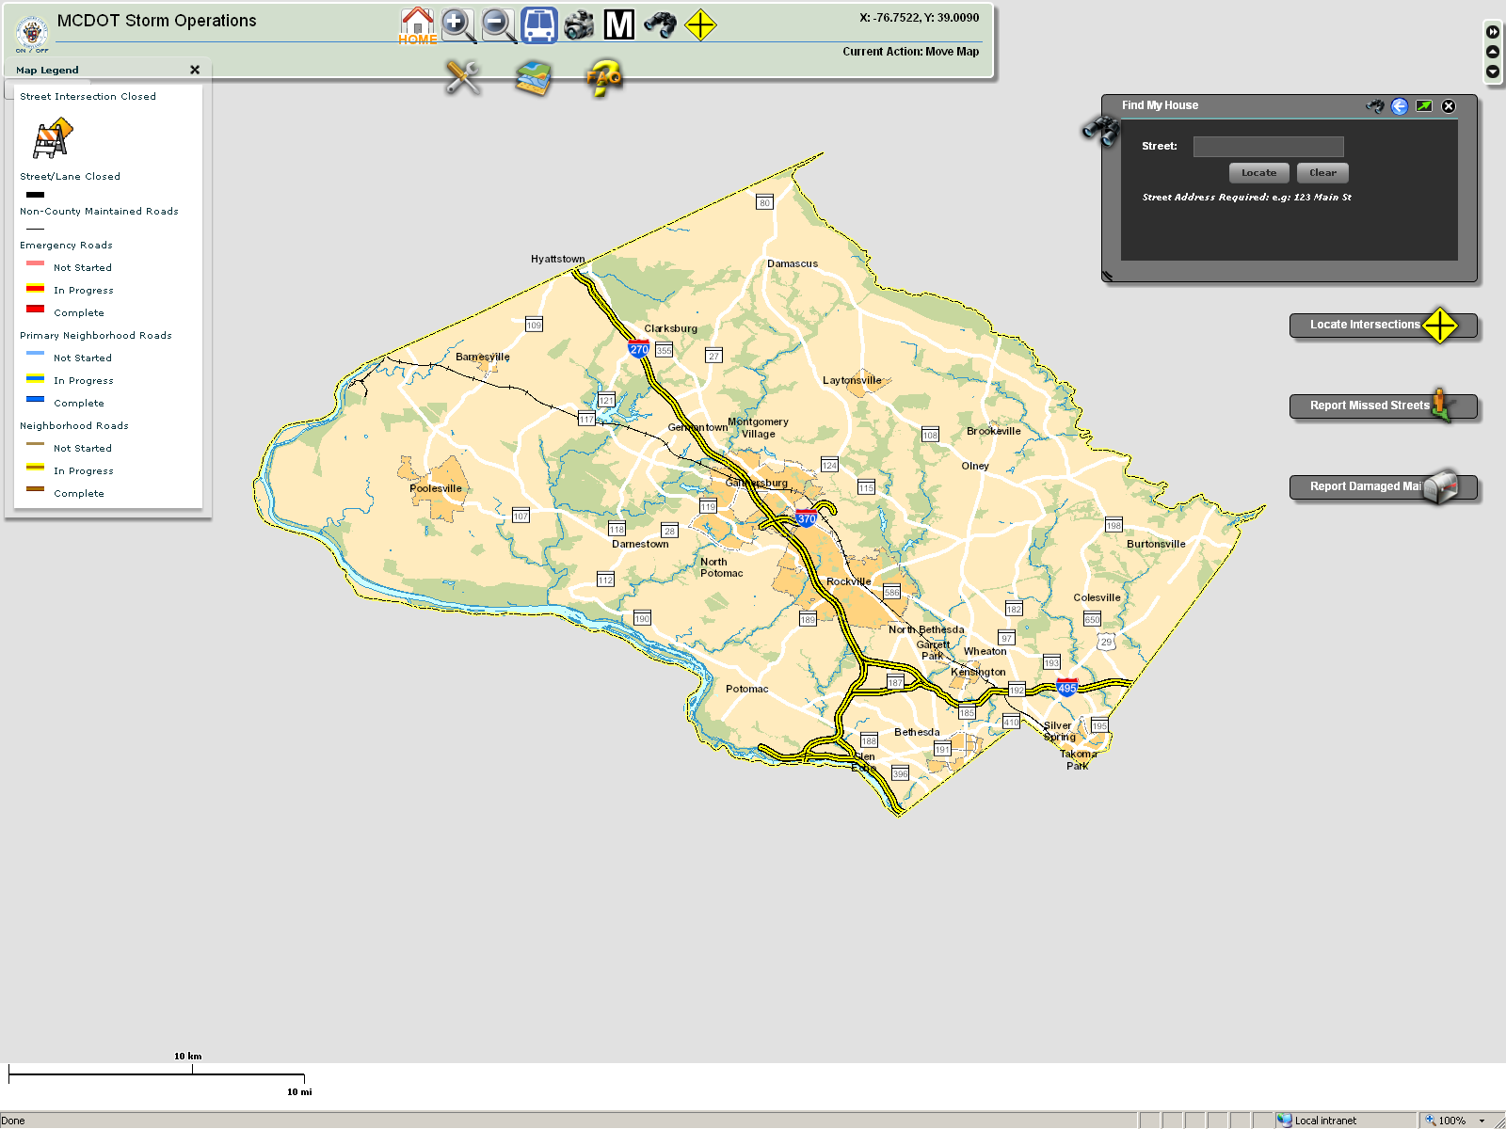

Slide 38
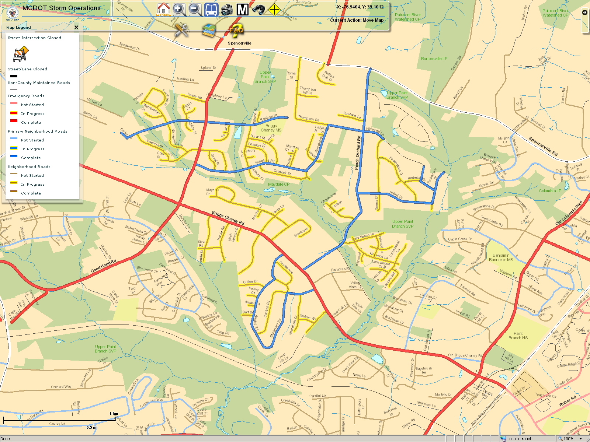

Slide 39
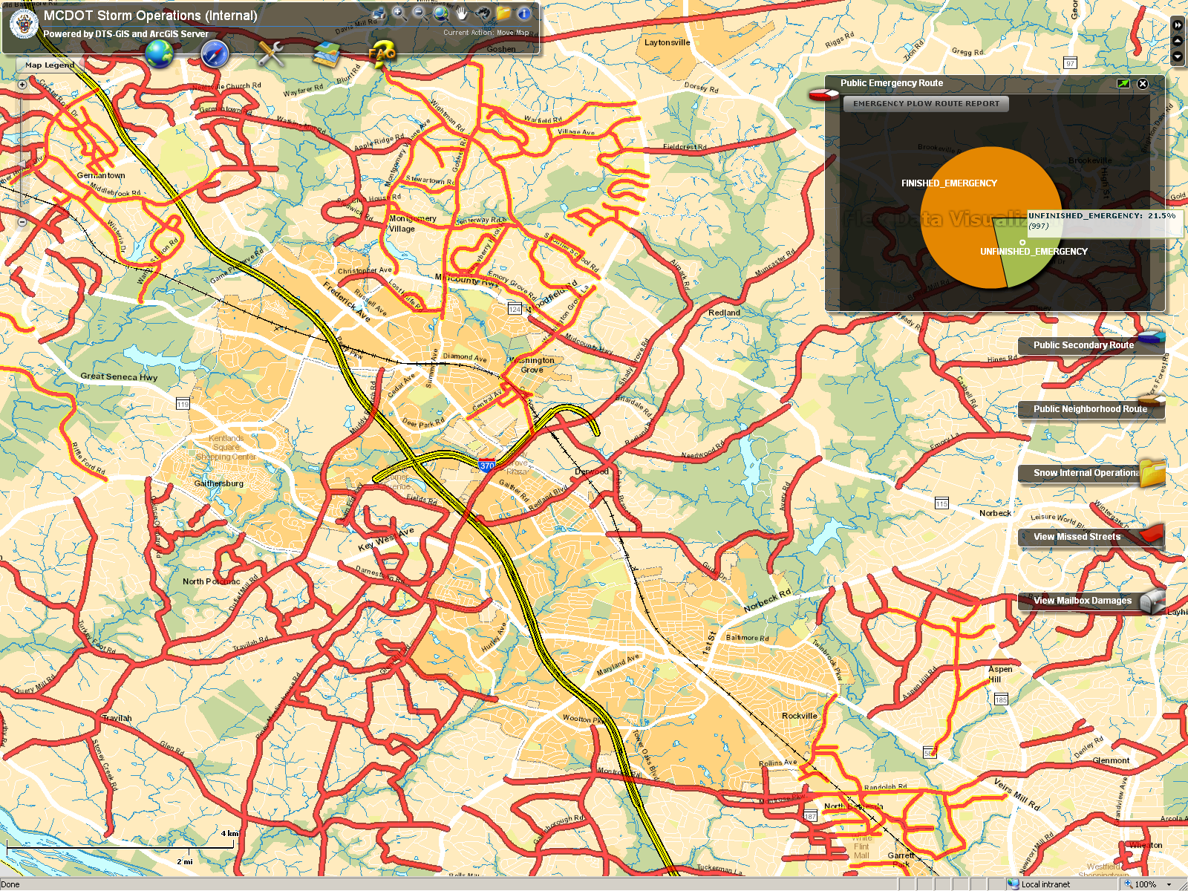

Slide 40



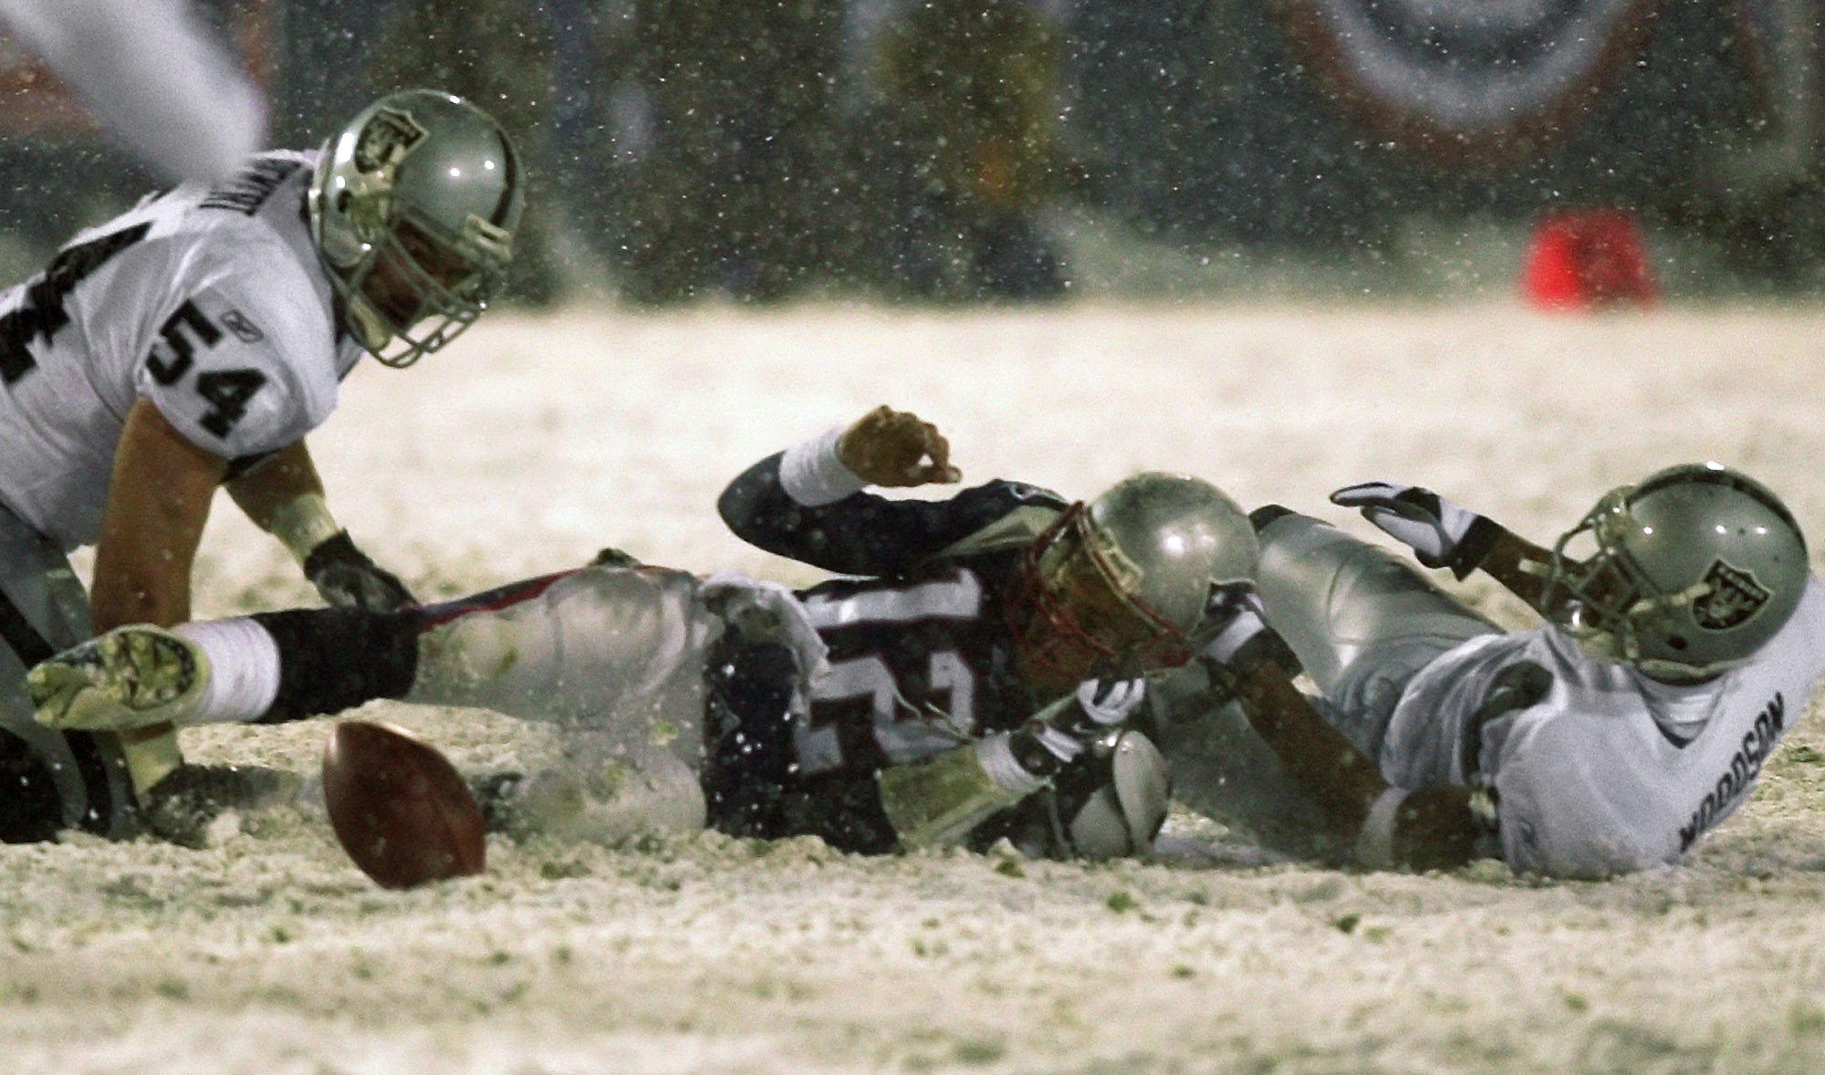
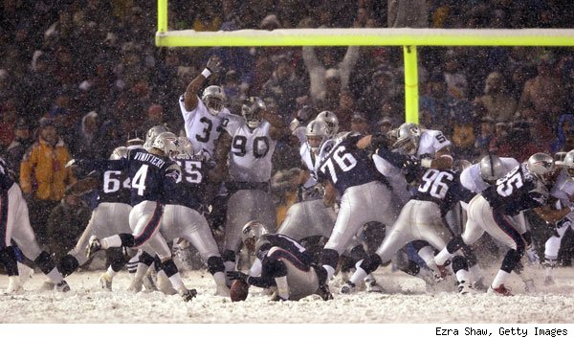
Game-on!
Taking the Field on Game Day

Slide 41
Players, Special Teams and Reserves List
200-225 Personnel
175 pieces of equipment
Contractor Resources to Supplement County
  180 contract personnel
  200-225 pieces of plowing/sanding equipment
  If needed additional large pieces with operators
Resource allocation based on actual “real time” conditions
  Increased effectiveness and efficiencies

Slide 42
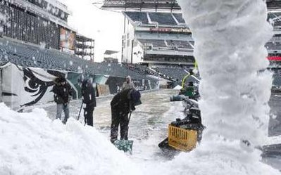
Special Teams
Emergency Strike Teams
  MCFRS with requisite apparatus (fire trucks, ambulance, etc.)
  MCPD to provide for safe haven
  DOT with dump truck and chain saws
  PEPCO to address live power lines
  The number of Strike teams is
  commensurate to the storm
  Addresses emergency access
  issues of unknown certainty
  All entities share single band
  radio frequency

Slide 43

Offensive Playbook
5 Tier Resource Deployment
0-2 inches
1-3 inches
3-7 inches
8-12 inches
>12 inches

Slide 44
Offensive Playbook
Resource load all plow routes

Slide 45
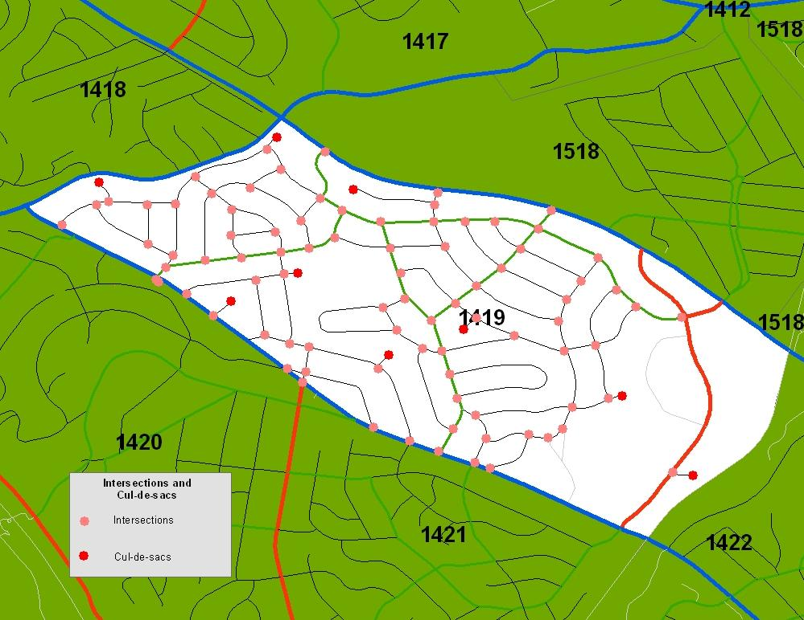
Residential Plow Route
Intersections (86)
Cul-de-sacs (7)

Slide 46
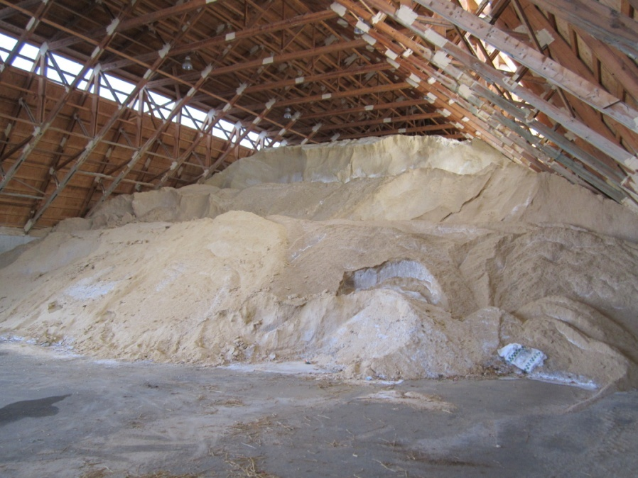
Playbook Strategies
46
Adoption of Salt Management Plan
  Quality operator training
  Improve record keeping
    Measure outputs
    Application rates
  Mapping of salt vulnerable areas
  Good house-keeping of salt
  storage facilities
  Identification of snow dump sites

Slide 47
Playbook Strategies
Pretreatment of Major Roadways
47
Includes all major roads (966 Lane Miles)
Brine manufactured in house
  Assures sufficient quantities to meet needs
Apply liquid anti-icer to roadway surface before storms
Cost effective treatment of pavement frost, black ice and snow removal
Reduces amount of salt applied
Introduces a significant safety factor
Easy and environmental friendly

Slide 48
Offensive Playbook - Core Strategy

Slide 49

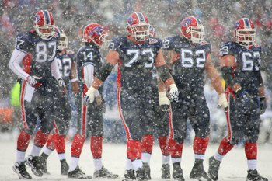
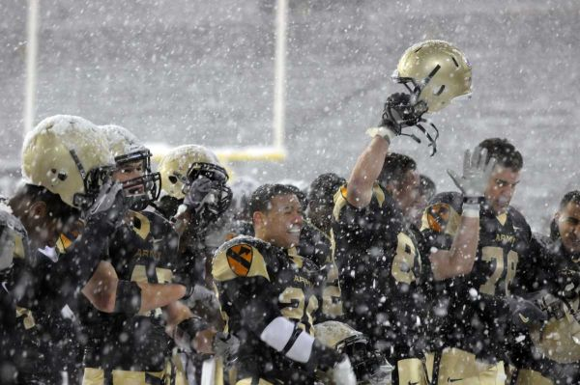
Post-game

Slide 50
Post-game Activities
After a storm has ended, crews continue operations with the following completion expectations
  Type of snow, ambient temperatures, road temperatures and wind conditions will alter the time frames

Slide 51
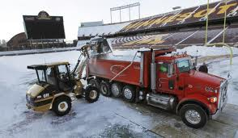
Post-game Activities
Notification to Special Teams, Reserve List, and other Leagues
Careful assessment of countywide road conditions and weather forecast
Reduce support as appropriate
Scale back depot resources
Activation of Lead Depot

Slide 52
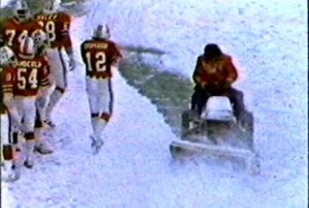
Post-game Activities
QA/QC storm cleanup
Inspect storm drainage
Replace mailbox knock downs (if any)
Activate pothole trucks
Prepare for next storm…
Risk management response

Slide 53
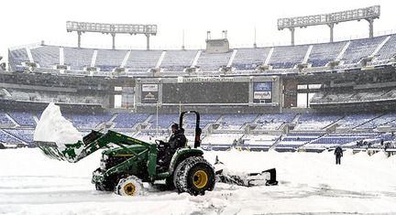
Post-game Activities
Condition of equipment and facilities
Status of county personnel
Status of contract resources
Material inventory
Weather forecasts
  Timing of next storm event
  (back-to-back storms)

Slide 54
Post-game Debriefing
DOT Senior Management
  County Executive, Chief Administrative Officers, and Elected Officials
District and Contract Supervisors
Inspection staff and contractors
MC311 Call Center
Review customer feedback
Self assessment
Increase effectiveness and efficiencies

Slide 55
Storm Analysis As-planned

Slide 56
Post-game Debriefing
Review Game Day Stats
Timeline
Snow and Wind
Equipment
Snow and Temperatures

Slide 57

Postseason

Slide 58

Postseason Review
Why the fuss about a speedy snow clean-up?
Who does it benefit?
Is the cost of clean up worth the overall effort?
After all, the snow will melt on its own, won’t it?

Slide 59
Postseason Review
According to a Global Insight study:
  The economic impact of snow related closures far exceed the cost of timely snow removal.
  The expenditure of upfront resources in the short-term, more than justifies the long-term payoff.
  A one-day major snowstorm can cost a state $300-$700 million on both direct and indirect costs.

Slide 60
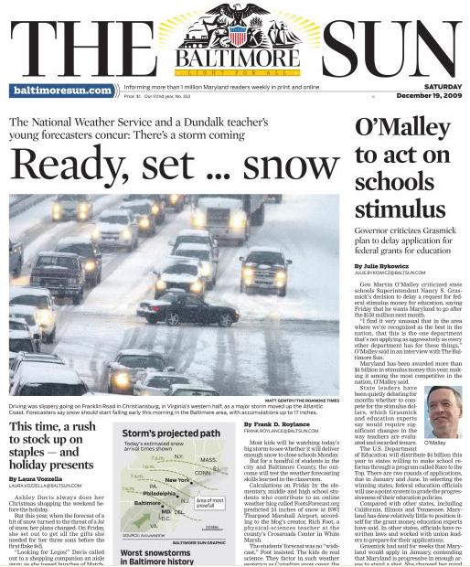
Postseason Review
Every winter, over 116,000 people are injured and over 1,300 are killed on America’s highways due to snowy, slushy, or icy roads
Nationally, snowstorms cost as
much as $700 million per day in
lost economic activity
It costs the Federal Government
$100 million per day to shutdown

Slide 61

Postseason Review
Global Objective
  Emergency Access
    Ensure accessible main road conditions for ALL Emergency Services
    All out effort by all field positions until such time as all county roads in a safe and passable condition
    Effective storm operations relates to intangible benefits such as quality and equity of service
Plan for the worst and hope for the best
Notes:
61

Slide 62
Postseason Review
Examine efficiencies
Examine shortcomings
Rate contractors
Assess communications
Consider all feedback (negative and positive)
Develop a “Self Rating”

Slide 63
Thanks to all:
There is no better time than the present to express our appreciation for your support.
The Montgomery County Department of Transportation’s Division of Highway Services thanks everyone for making a difference towards our winter snow plowing and removal operations.

Slide 64


